Slide 1
Introduction to Parallel Programming with CUDA
Nvidia GPU Device Shared and Constant Memory

Slide 2
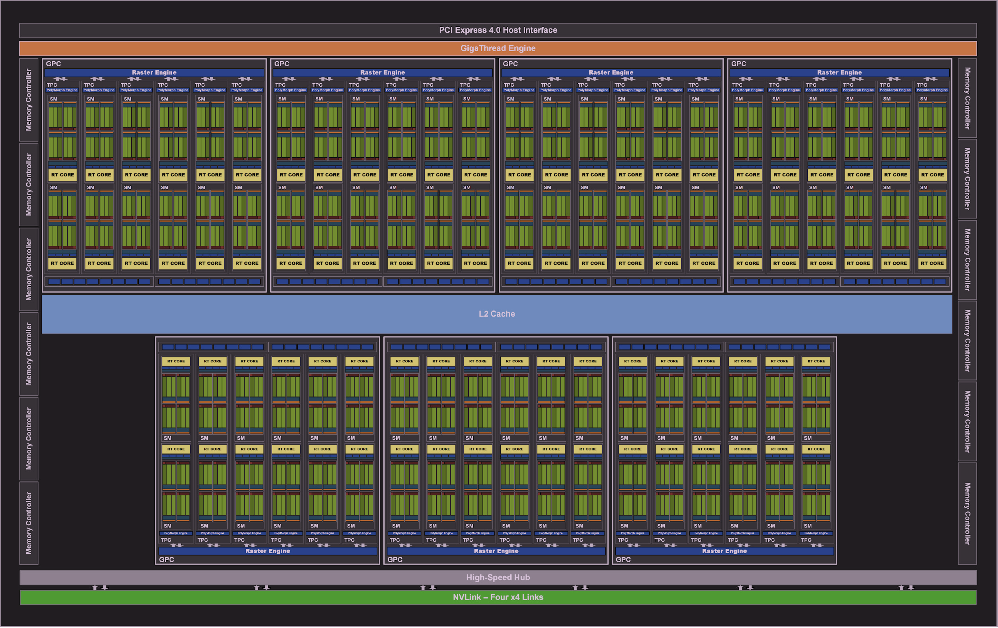
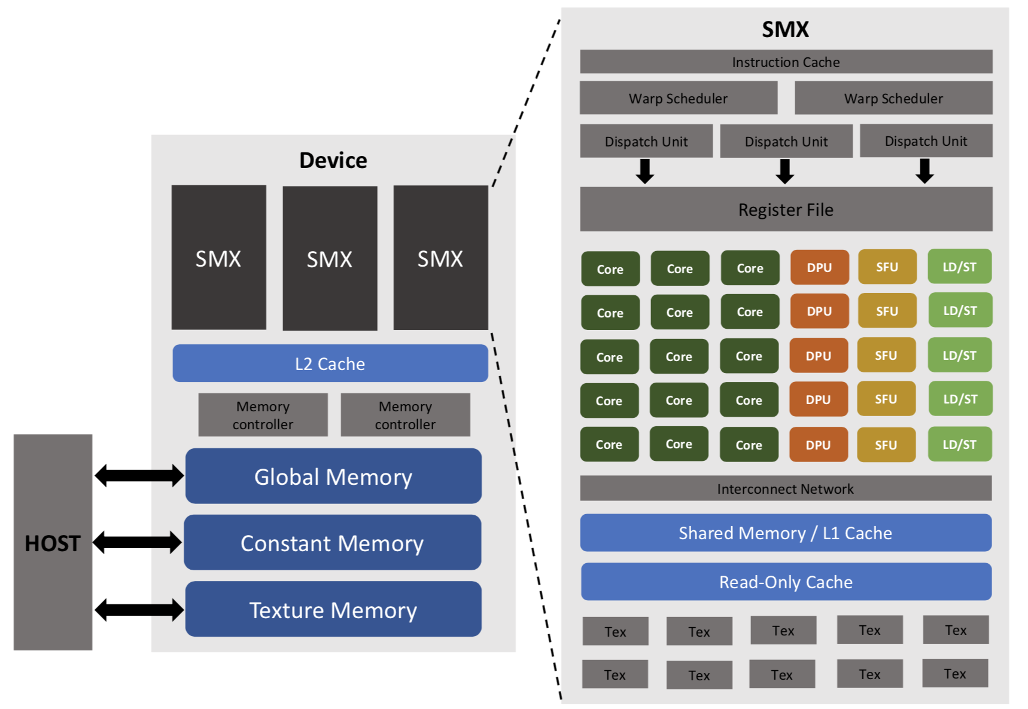
Nvidia GPU Device Layout
[1]
[2]

Slide 3
GPU Device L2/Constant Memory By Architecture
Tesla (2008-2010) – 16 – 64 KB
Fermi (2010-2012) – 256 – 768 KB
Kepler (2012-2014) - 256 – 1536 KB
Maxwell (2014-2016) – 1- 2 MB
Pascal (2016-2018) – 256 KB – 4 MB
Volta (2018-2019) – 4.5 – 6 MB
Turing (2019-2020) – 1 – 6 MB
Ampere (2020-) – 2 – 48 MB

Slide 4
GPU Device Shared Memory By Architecture
Tesla (2008-2010) – Not applicable as no L1 Cache
Fermi (2010-2012) – 64 KB per SM
Kepler (2012-2014) – 16 KB per SM
Maxwell (2014-2016) – 64 KB per SM
Pascal (2016-2018) – 16– 48 KB per SM
Volta (2018-2019) – 96 - 128 KB
Turing (2019-2020) – 64 KB
Ampere (2020-) – 128 – 192 KB

Slide 5
Bibliography
[1] 2020. Nvidia. Nvidia Ampere GA102 GPU Architecture. Retrieved from https://images.nvidia.com/aem-dam/en-zz/Solutions/geforce/ampere/pdf/NVIDIA-ampere-GA102-GPU-Architecture-Whitepaper-V1.pdf.
[2] Y Arafa, AHA Badawy, G. Chennupati. 2019. IEEE High Performance Extreme Computing Conference (HPEC). 24-26 Sept. 2019. Waltham, MA, USA. IEEE. https://doi.org/10.1109/HPEC.2019.8916466.
[3] 2021. TechPowerUp. TechPowerUp GPU Database. 2021 Retrieved from https://www.techpowerup.com/gpu-specs/

